Slide 1
How to get your dreaM JOB Resume & job hunting tips
Andy Mallon

Slide 2

Slides & content available on GitHub
PowerPoint Slides
My annotated resume
am2.co/dream-job-ppt

Slide 3
Andy Mallon
Product Manager at SentryOne
Working with SQL Server since 2003 and SQL Server 2000
Background in Tech Support
Managed databases in many industries
Lazy
Impatient
Healthcare
Finance
E-Commerce
Non-Profit

Slide 4


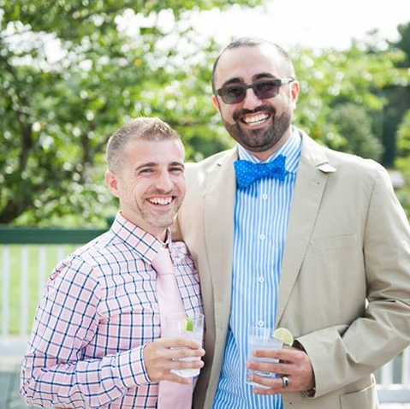
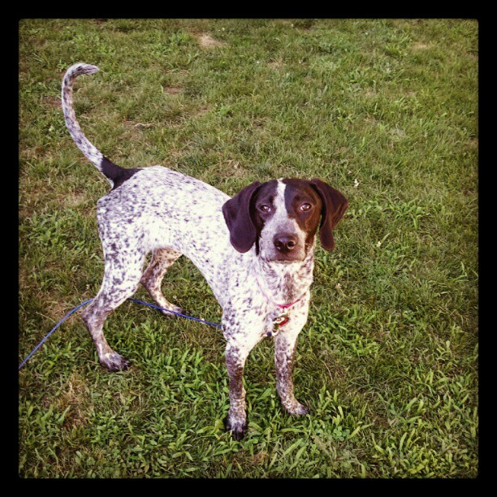




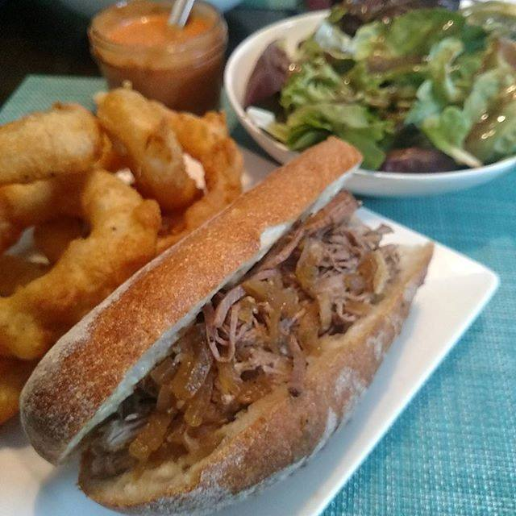




Slide 5
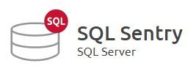

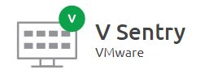
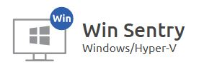
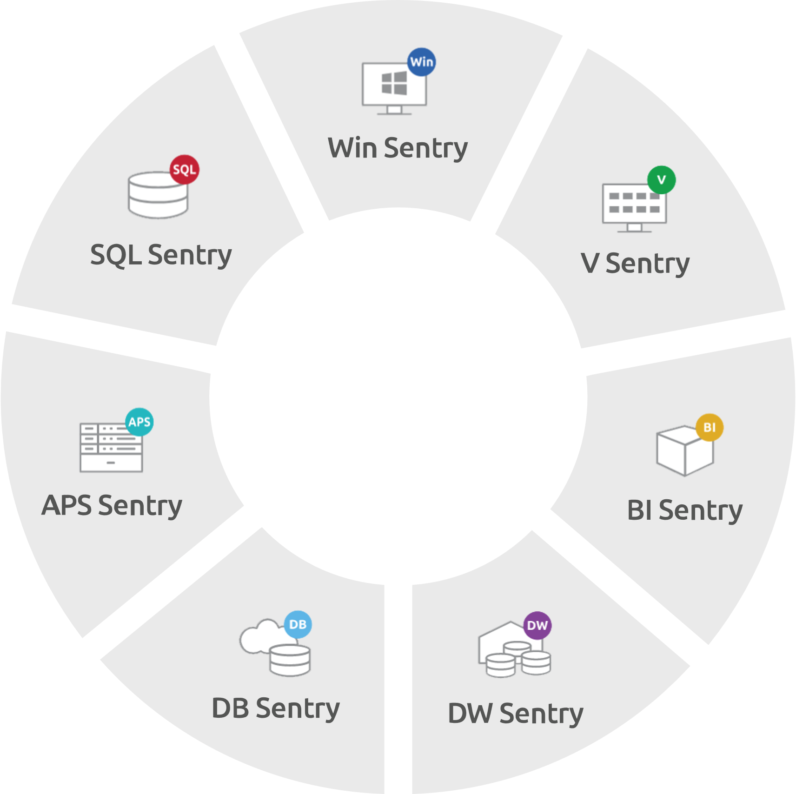
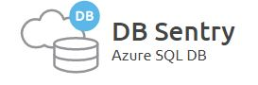
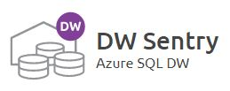
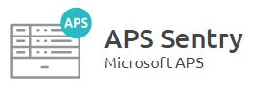


S1 Provides End-to-End Visibility Across the Data Platform
Monitor, diagnose, and optimize SQL Server performance.
Find and fix SQL Server Analysis Services (SSAS) performance problems
Monitor resource utilization (memory, CPU, network, storage) of virtualized environment.
Boost Windows Server and Hyper-V virtualized environment performance.
Keep Azure SQL Databases running at peak efficiency with performance metrics including DTU usage.
Accelerate Azure SQL Data Warehouse performance with visibility into workload impacts.
See performance information for Microsoft Analytics Platform system, including data movement and details about distributed queries.

Slide 6


Contact Andy
Andy@AMtwo.co
@AMtwo
amtwo.co
andy@amtwo.co

Slide 7

Who uses Slack?
If nvarchar(280) isn’t enough
#sqlhelp #powershellhelp #ssrshelp
http://www.dbatools.io/slack for details
Notes:
Who doesn’t want free advice from Brent Ozar or Aaron Bertrand?

Slide 8

Session Feedback
Tell me what you don’t like
Tell me what can be better
Tell me what you like

Slide 9


Yea…….You apparently didn’t put one of the new coversheets on your TPS reports.
I'm also gonna need you to go ahead and silence your phones and devices

Slide 10
Agenda
My story – Why I’m living my dream
Setting your career goals
How to write a bad resume
How to write a good resume (why it matters)
How to navigate a job interview
How to navigate a job offer

Slide 11

Warning: I’m American
This topic is cultural
My advice comes from my experience & perspective
Tech industry
United States

Slide 12
My story: Why I’m living my dream

Slide 13






My story isn’t particularly unique
First tech job
Blogging + speaking
University
First job
First DBA job
Today

Slide 14


Education

Slide 15


My first job

Slide 16

My first tech job

Slide 17

My first DBA job

Slide 18
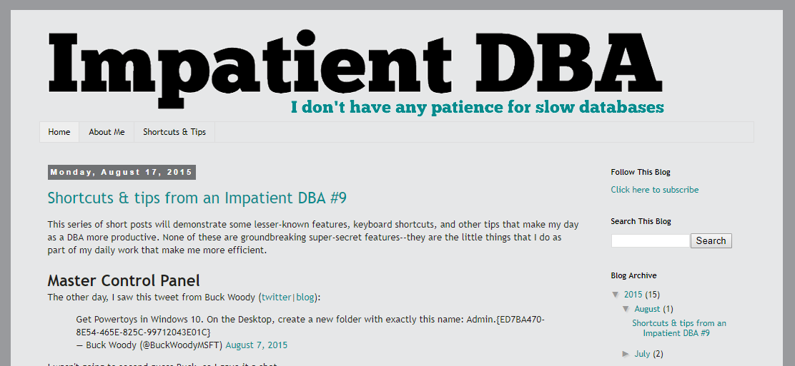
Blogging + speaking
Notes:
In May 2014, I started blogging. I wrote 3 blog posts in 2014.
In the first 12 months, I wrote 6 blog posts.
In the following 12 months, I wrote 33 blog posts, and started speaking at user groups & SQLSaturday

Slide 19


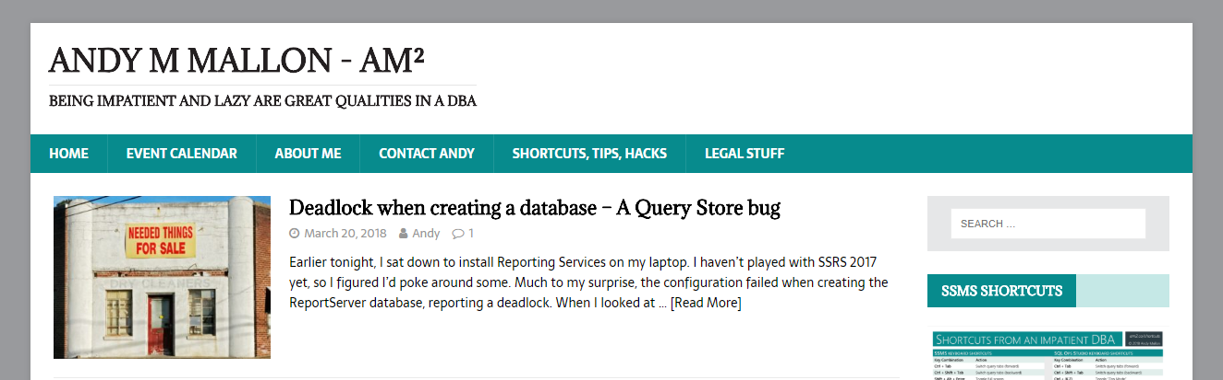



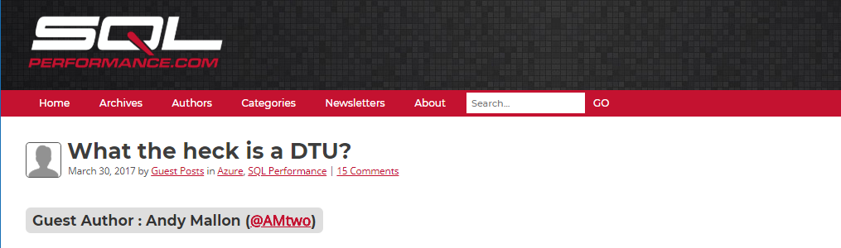



Today

Slide 20
Setting your career goals

Slide 21
What do you want to do?
“You can do anything if you put your mind to it”
This is totally a lie
I will never be an opera singer

Slide 22
Where do you want to be?

Slide 23
How can you get there?

Slide 24
Who can help you get there?
Networking is important
Referrals / references are important
Sponsorship / mentorship can be tremendously helpful

Slide 25
How to write a bad resume

Slide 26

Bad resumes are…
Sloppy
Long
Repetitive
Inconsistent
Ugly
Careless
Unprofessional

Slide 27
Avoid these common pitfalls
Irrelevant jobs don’t belong on your resume
Is “perfume counter at Macy’s” relevant?
Don’t repeat the same thing for every job
“Responsible for backup & recovery” is implied in DBA
Put it on the most relevant job

Slide 28
Be professional
Professional tone
Professional language
Professional formatting

Slide 29
Be yourself
Don’t over-sell yourself
Don’t under-sell yourself
Don’t hide your personality

Slide 30
Professional Email Address
Use your name
Don’t give away your age
Use a professional domain
Don’t use BostonHottieGuy666@butz.com

Slide 31
How to write a good resume

Slide 32

Good resumes are…
Tidy
Concise
Tell a story
Accurate
Pretty
Thoughtful
Professional

Slide 33
Nobody wants to read your resume
Start with the most important bits
Grab the reader’s attention early
Understand the inverted pyramid
Don’t bury the lede

Slide 34
Most résumé-worthy
Important details
Other info
Who
What
When
Where
Why
Notable projects
Major accomplishments
Current job information
Complete relevant work history
Additional details on notable projects
Education history

Slide 35
Inverted Pyramid
If someone stops reading ½ of a page in…
Did they get a good initial picture of you?
Did you want to tell them something else?
You should feel good about their decision

Slide 36
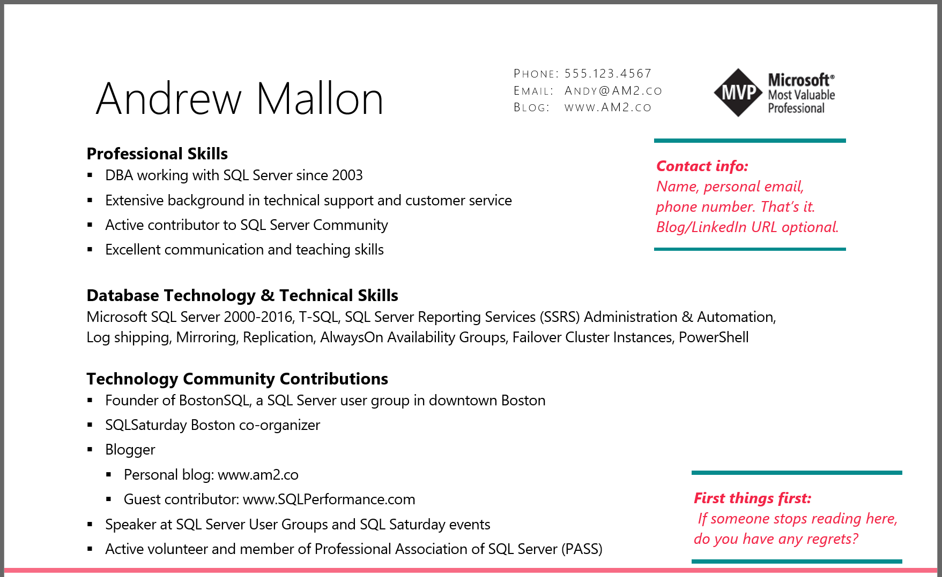

Slide 37
Spice up your experience with detail
Boring
Exciting
Responsible for backups and restores of SQL Server databases.
Standardized backup process across all 100 servers in environment; Implemented automated process to regularly test restores of every database.

Slide 38
Spice up your experience with detail
Boring
Exciting
Performance tuned queries
Reduced CPU utilization by 20% over 6 months, by focusing on performance in code review, as well as proactive performance monitoring & tuning

Slide 39
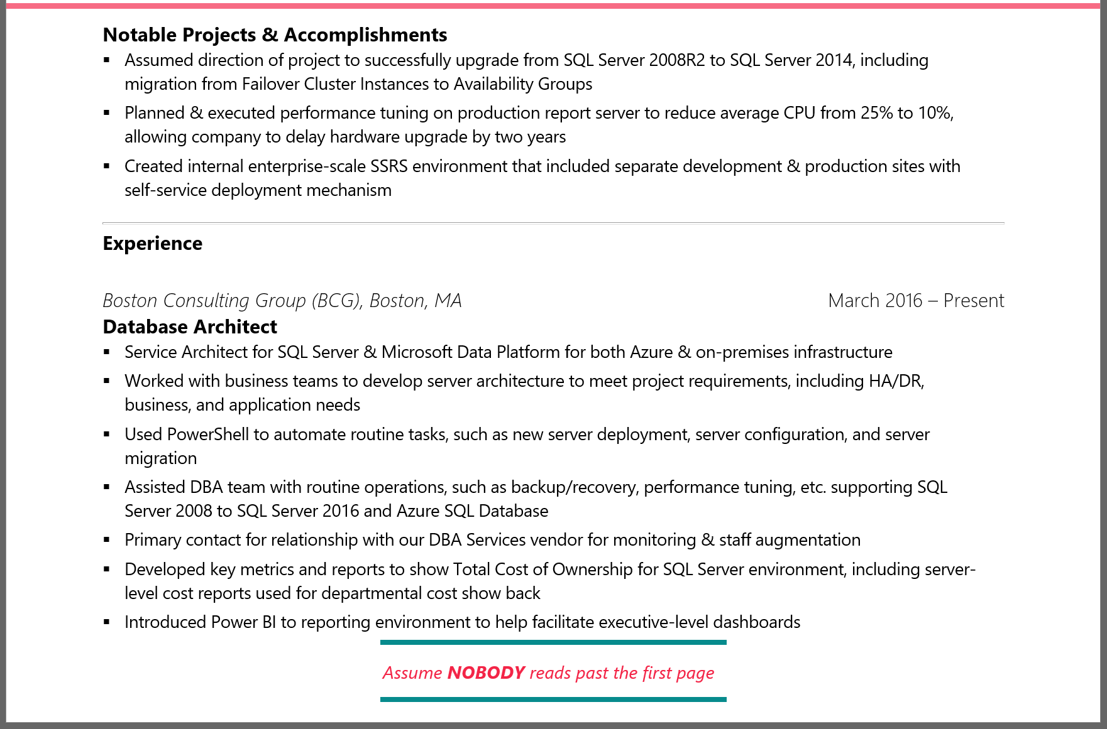
Notes:
I’m no longer with the Boston Consulting Group—This is a slightly dated resume…

Slide 40
Hide important facts about yourself
Are you a woman?
Are you a minority?
Are you young? Old?
Are you a “protected class”?
Why might someone have implicit bias against you?

Slide 41
What is “implicit bias”
Implicit stereotypes are based on learned associations between various qualities and social categories, including race or gender.
Individuals' perceptions and behaviors can be affected by implicit stereotypes, even without the individuals' intention or awareness.
Notes:
The keyword here is *LEARNED* … Society teaches us these things, not always experience.

Slide 42
What is “implicit bias”
If you’re not a straight white dude…
Someone might hold that against you…
And not even realize it

Slide 43
Implicit bias give-aways
Stereotypical names around gender or ethnicity
J. Jones instead of Jamal Jones
K.D. Lang instead of Kathryn Dawn Lang
Historically black/female colleges
Year of graduation
“Smith College, 1982”

Slide 44
How to navigate a job interview

Slide 45

Be prepared
Research the company
Check LinkedIn for connections
Research the position

Slide 46

Be prepared
What do you want to learn from them?
What do you want them to learn from you?

Slide 47
Be yourself
You are better at being you than you are at being someone else
They are hiring you
If you land the job, they’ll meet “the real you” eventually

Slide 48
Dress appropriately
You don’t always have to wear a suit!
What’s the best-dressed day you would have at this job?
Dress for that day

Slide 49

Tell your story

Slide 50
How to navigate a job offer

Slide 51
Is the job right for you?
Will you be happy?
People
Work
Commute
Money
Work-life balance

Slide 52
Is the employer right for you?
Industry
Management
Team dynamics
Socio-political leanings

Slide 53
Questions?
am2.co/2016/07/job-hunting-database-professionals/

Slide 54
Resources
https://youtu.be/ib04UR2KRMc?t=6m05s
Andy’s professional development musings
https://am2.co/category/professional-development/
Steph Locke’s one-page CV template
https://www.overleaf.com/articles/steph-lockes-one-page-cv/wbttfmfqcdtq
Write a killer technical resume in five steps
https://www.brentozar.com/archive/2012/09/write-killer-technical-resume-five-steps/
Rie Irish “Let Her Finish” webinar
https://youtu.be/ib04UR2KRMc?t=6m05s

